Slide 1
A Plausibility Argument
for the Uncertainty Principle

Slide 2
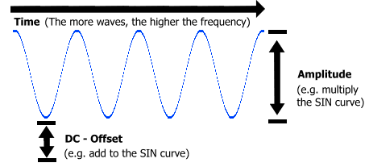
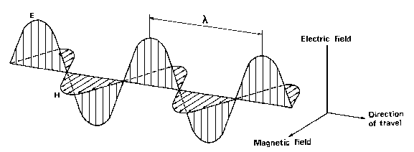
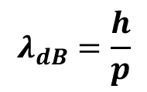
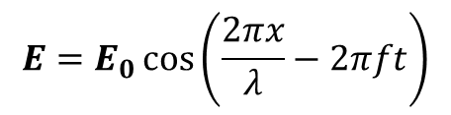






waves go on forever...
A wave that propagates forever in one dimension is described by:
$$E=E_{0}\cos\left(\frac{2πx}{λ}−2πft\right)$$
$$c=λf$$
in shorthand:
$$E=E_{0}\cos\left(kx−ωt\right)$$
angular frequency
wave number
In the quantum description of a particle, the wavelength represents the momentum
$$λ_{dB}=\frac{h}{p}$$
$$Ψ\left(x,t\right)=Ψ_{0}e^{i\left(kx−ωt\right)}$$
For this kind of wave the momentum
has a single value, with no uncertainty
$$p=ℏk$$
and
$$σ_{p}=0$$
or
$$Δp=0$$
But *where* is the wave????

Slide 3
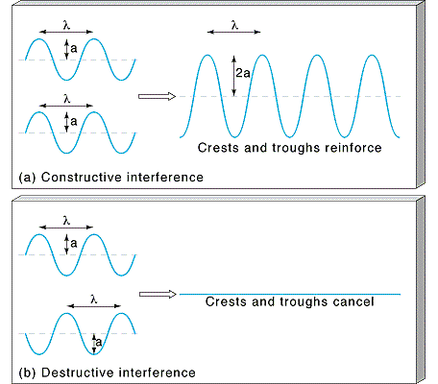
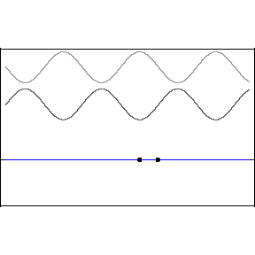
Interference
Because of linear superposition waves can interfere (add or cancel)
Recall that we built linearity into the Schrodinger equation!

Slide 4
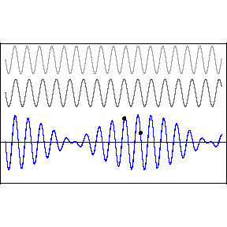
How to Make a Localized Wave?
Interefering waves, generally…
“Beats” occur when you add two waves of slightly different frequency. They will interfere constructively in some areas and destructively in others.
Can be interpreted as a sinusoidal envelope:
Modulating a high frequency wave within the envelope:

Slide 5
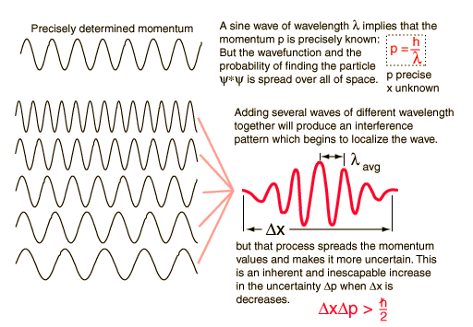
FOURIER THEOREM: any wave packet can be expressed as a superposition of an infinite number of harmonic waves
Adding several waves of different wavelengths together will produce an interference pattern which begins to localize the wave.
To form a pulse that is zero everywhere outside of a finite spatial range Dx requires adding together an infinite number of waves with continuously varying wavelengths and amplitudes.
adding varying amounts of an infinite number of waves
spatially localized wave group
sinusoidal expression for harmonics
amplitude of wave with wavenumber k=2p/l

Slide 6
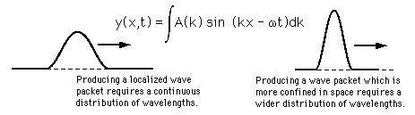
The Uncertainty Principle
Remember the cosine wave that went on “forever”?
We knew its momentum very precisely, because the momentum is a function of the wavelength, and the wavelength was very well defined.
But what is the wavelength of a localized wave packet? We had to add a bunch of waves of different wavelengths to produce it.
x
x
Consequence: The more localized the wave packet in space, the less precisely defined is the momentum.

Slide 7
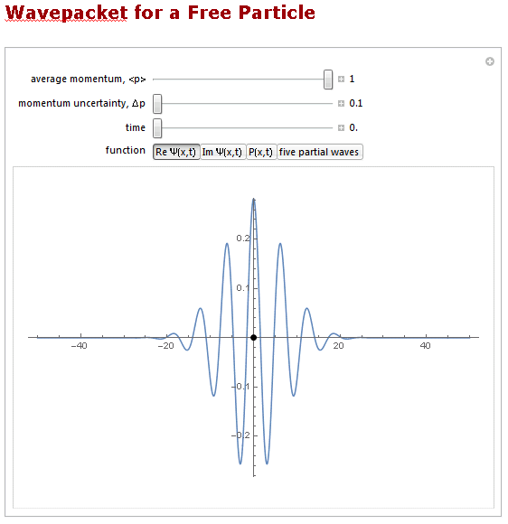
http://demonstrations.wolfram.com/WavepacketForAFreeParticle/

Slide 8
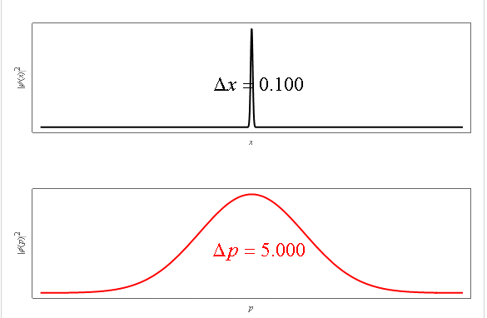
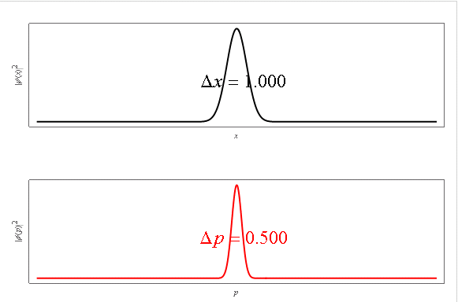
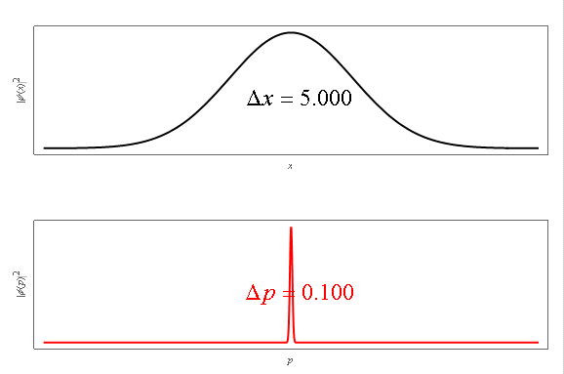









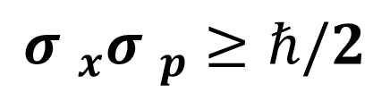




Uncertainty Relation for Gaussian Wavepackets
$${\left|ψ(x)\right|}^{2}$$
$${\left|ψ(x)\right|}^{2}$$
$$x$$
$$x$$
$${\left|φ(p)\right|}^{2}$$
$${\left|φ(p)\right|}^{2}$$
$$p$$
$$p$$
$$∆x ∆p=1/2$$
$${\left|ψ(x)\right|}^{2}$$
(ħ = 1 in this simulation)
$$x$$
Later we will show:
$${σ }_{x}{σ }_{p}≥ℏ/2$$
$${\left|φ(p)\right|}^{2}$$
$$p$$
http://demonstrations.wolfram.com/EvolutionOfAGaussianWavePacket/

Slide 9
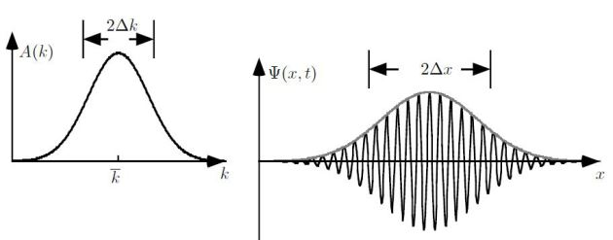

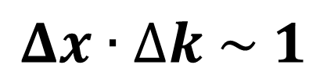
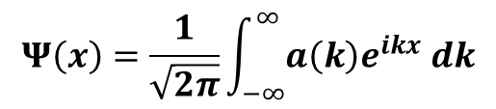
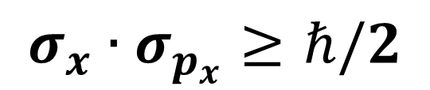
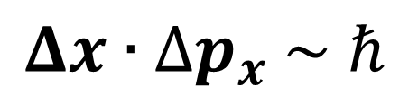
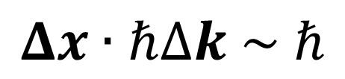

$$a(k)$$
$$Ψ\left(x\right)$$
$$Ψ\left(x\right)=\frac{1}{\sqrt{2π}}\int_{−∞}^{∞}{a\left(k\right)e^{ikx} dk}$$
Wave Uncertainty Relation
$$Δx∙∆k \sim 1$$
Translating to Quantum Mechanics:
$$Δx∙ℏ∆k \sim ℏ$$
$$Δx∙∆p_{x} \sim ℏ$$
or
Ultimately we will show that
$$σ_{x}∙σ_{p_{x}}≥ℏ/2$$

